Slide 1

A101 Science
Problem 01: Rescue Mission
6th Presentation
Copyright © 2010

Slide 2
Understanding the problem
There are some differences between blood of certain groups of individuals.
In order for blood transfusion to be successful, the donor and recipient’s blood type must be matched.

Slide 3
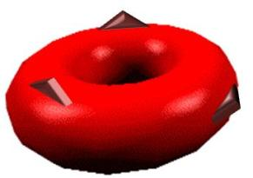
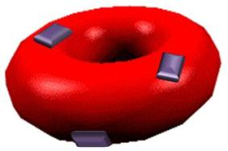
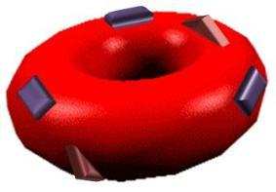
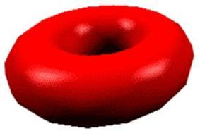
Difference between blood types –
Blood Type Molecules
Closer examination of blood reveals the presence of surface molecules on the red blood cells of some individuals:
Note: These are only representations of red blood cells and surface molecules
The effect of having different surface molecules (as shown above) can be tested by mixing donor and recipient blood samples. The observations in the following slides are made:

Slide 4
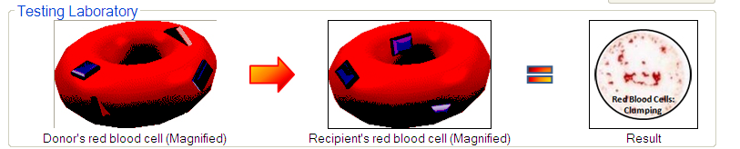
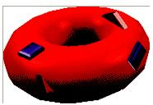
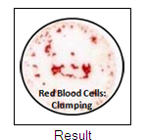
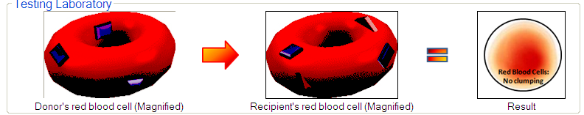
Difference between blood types –
Effect on Transfusion
When donor red blood cells have foreign (not found on the recipient’s red blood cells) surface molecules, clumping of red blood cells is observed.
Otherwise, no clumping occurs.
Foreign to recipient
Found on both donor and recipient’s red blood cell

Slide 5
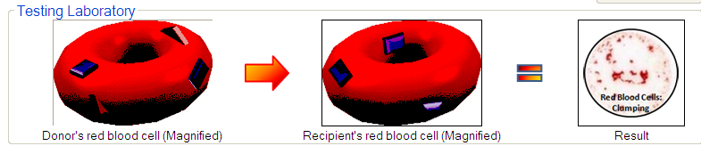
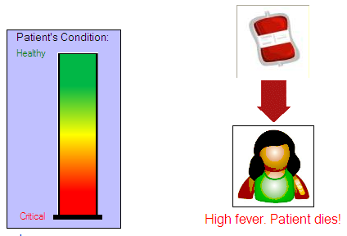
Difference between blood types –
Effect on Transfusion
If the donor’s blood produces clumping when mixed with the recipient’s blood, the transfusion fails.

Slide 6




Difference between blood types –
Effect on Transfusion
The presence of foreign surface molecules on donor
red blood cells causes transfusions to fail.
Medical professionals and doctors named the different types of
blood based on the presence or absence of such molecules:
The matching of donor blood types to recipient blood types
drastically increased the success rate of transfusions.
ABO Typing System
A
B
AB
O

Slide 7
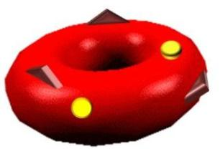
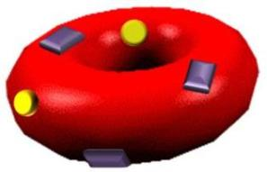
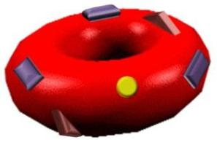
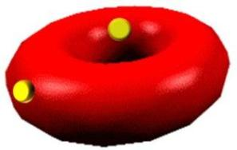
Difference between blood types –
Other Surface Molecules
The discovery of the Rhesus Protein expanded the ABO typing system:
ABO Typing System – Including Rhesus Protein
A+
B+
AB+
O+
A-
B-
AB-
O-

Slide 8
Difference between blood types –
Other Surface Molecules
Over time, more surface molecules with different functions were discovered.
  Basis for other typing systems (e.g. the MNS, Kell, Duffy, Lewis systems).
  Common red blood cell functions (e.g. carrying of oxygen). These molecules are less likely to cause transfusions to fail, as they are less likely to be foreign to recipients.

Slide 9
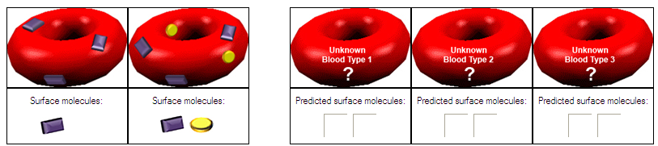
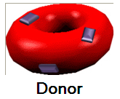
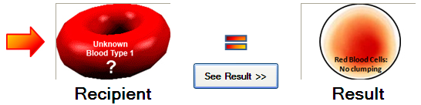
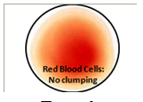

Stage 6
In order to identify the surface molecules on each of the
unknown blood types, we need to conduct a series of tests.
Not foreign to recipient
Unknown blood type 1 has .

Slide 10
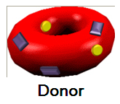
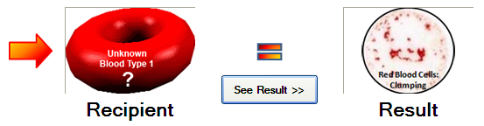
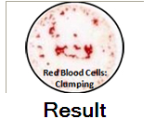

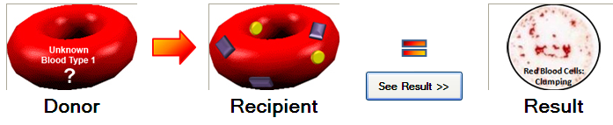

Stage 6
Foreign to recipient
Unknown blood type 1 does not have .
Unknown blood type 1 contains a foreign surface molecule.
Unknown blood type 1 must have .

Slide 11

Stage 6
Therefore, the unknown blood type 1 has the following surface molecules:
Similar tests can be used to determine the surface molecules of the other unknown blood types.

Slide 12
Learning points
Although blood may look similar for different individuals, there are different types of blood.
Blood typing is based on the blood type molecules that are present or absent on the surface of red blood cells.
A molecule that a recipient does not already have is foreign to him/her. Using donor blood that contains foreign molecules will cause blood transfusions to fail.
The application of these concepts allows the success of blood transfusions to be greatly improved.

Slide 13
Discussion
Study the relation below.
Person
A
Can donate blood successfully to
Person
B
Can donate blood successfully to
Person
C
Can donate blood successfully to
Person
E
Person
D
Can donate blood successfully to
Discuss and explain your answers to the following questions.
Can Person A donate blood successfully to Person E?
Can Person E donate blood successfully to Person A?

Slide 14
Post-Problem Reading
Blood donation:
Source:
Trail of Blood (3 Oct 2009). The Straits Times, pp D11.

